Slide 1
R. GLENN HUBBARD
ANTHONY PATRICK O’BRIEN
FIFTH EDITION
© 2015 Pearson Education, Inc.

Slide 2
Firms in Perfectly Competitive Markets

Slide 3
Market structures
For the next few chapters, we will examine several different market structures: models of how the firms in a market interact with buyers to sell their output.
The market structures we will examine are, in decreasing order of competitiveness:
Perfectly competitive markets
Monopolistically competitive markets
Oligopolies, and
Monopolies.
Each market structure will be applicable to different real-world markets, and will give us insight into how firms in certain types of markets behave.

Slide 4
Table of market structures
 | Market Structure
Characteristic | Perfect Competition | Monopolistic Competition | Oligopoly | Monopoly
Number of firms | Many | Many | Few | One
Type of product | Identical | Differentiated | Identical or differentiated | Unique
Ease of entry | High | High | Low | Entry blocked
Examples of industries | • Growing wheat • Growing apples | • Clothing stores • Restaurants | • Manufacturing computers • Manufacturing automobiles | • First-class mail delivery • Tap water
Table 12.1
The four market structures

Slide 5
Perfectly Competitive Markets
12.1
Explain what a perfectly competitive market is and why a perfect competitor faces a horizontal demand curve.

Slide 6
Introduction to perfectly competitive markets
The first market structure we will examine is the perfectly competitive market: one in which
There are many buyers and sellers;
All firms sell identical products; and
There are no barriers to new firms entering the market
The first and second conditions imply that perfectly competitive firms are price-takers: they are unable to affect the market price. This is because they are tiny relative to the market, and sell exactly the same product as everyone else.
As you might have already guessed, perfectly competitive markets are relatively rare.

Slide 7
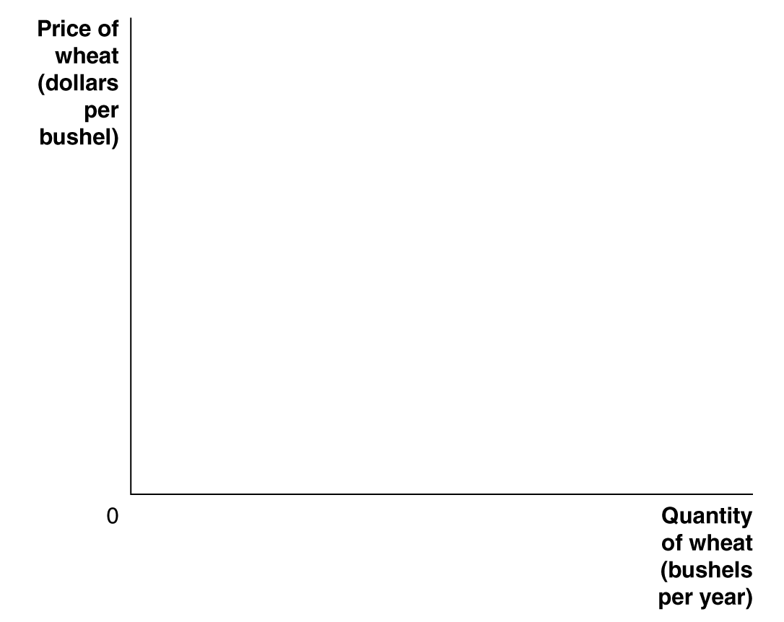
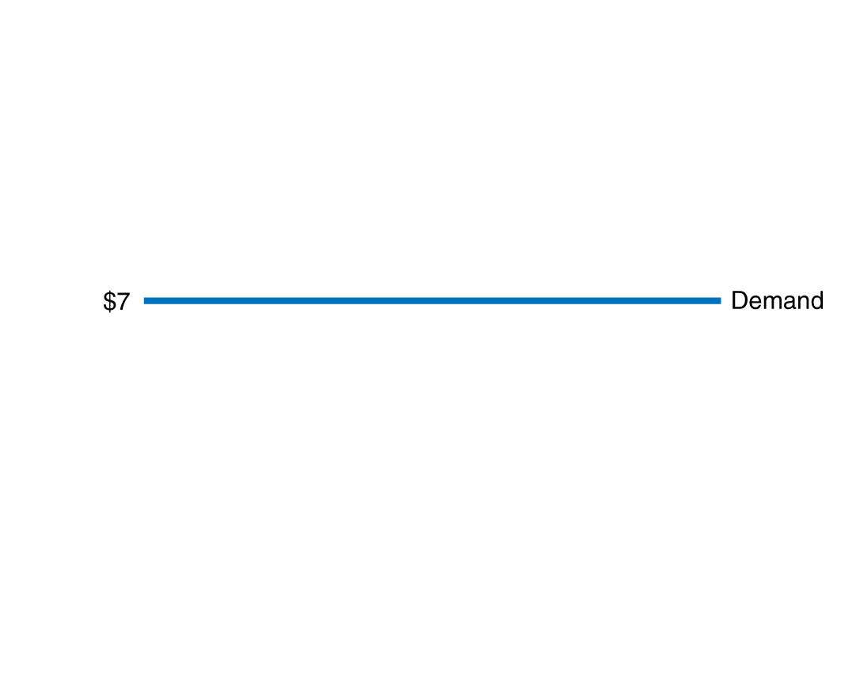
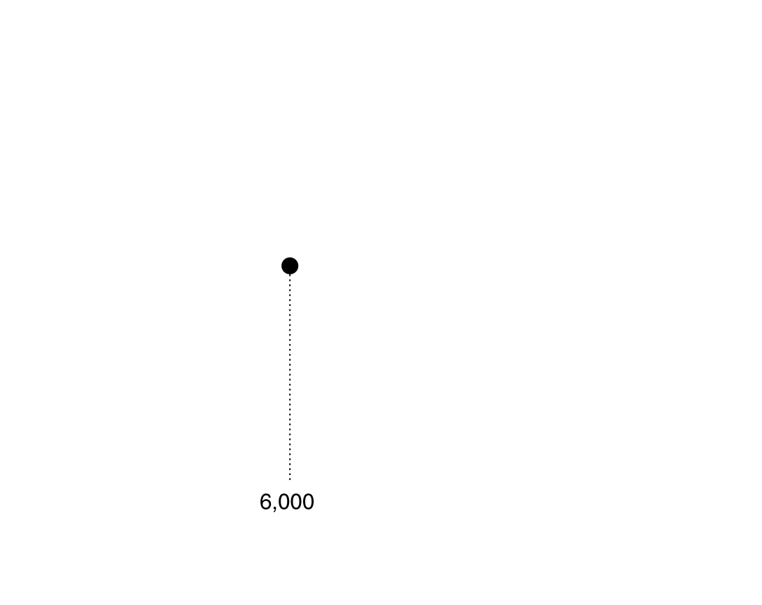
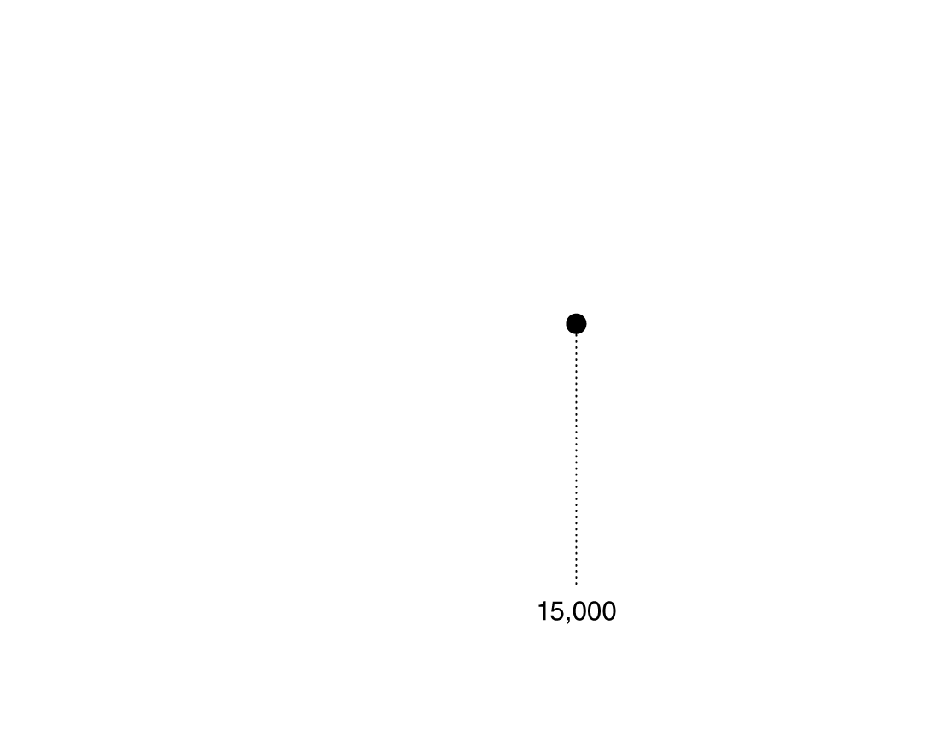
The demand curve for a perfectly competitive firm
By definition, a perfectly competitive firm is too small to affect the market price.
Agricultural markets, like the market for wheat, are often thought to be close to perfectly competitive.
Suppose you are a wheat farmer; whether you sell 6,000…
… or 15,000 bushels of wheat, you receive the same price per bushel: you are too small to affect the market price.
Figure 12.1
A perfectly competitive firm faces a horizontal demand curve
Notes:
A firm in a perfectly competitive market is
selling exactly the same product as many
other firms. Therefore, it can sell as much
as it wants at the current market price, but
it cannot sell anything at all if it raises the
price by even 1 cent. As a result, the demand
curve for a perfectly competitive firm’s
output is a horizontal line. In the figure,
whether the wheat farmer sells 6,000 bushels
per year or 15,000 bushels has no effect
on the market price of $7.

Slide 8
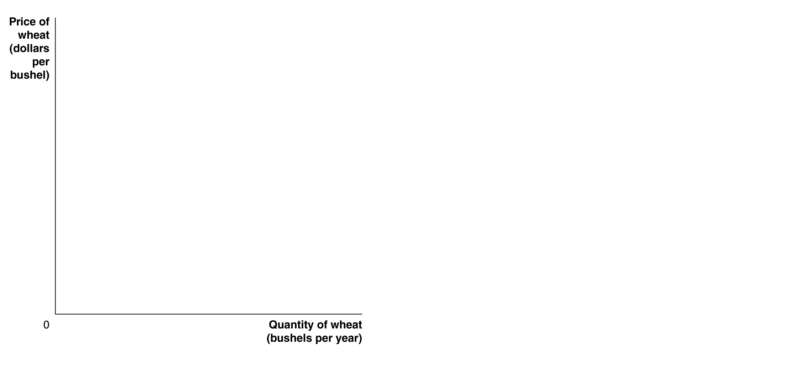
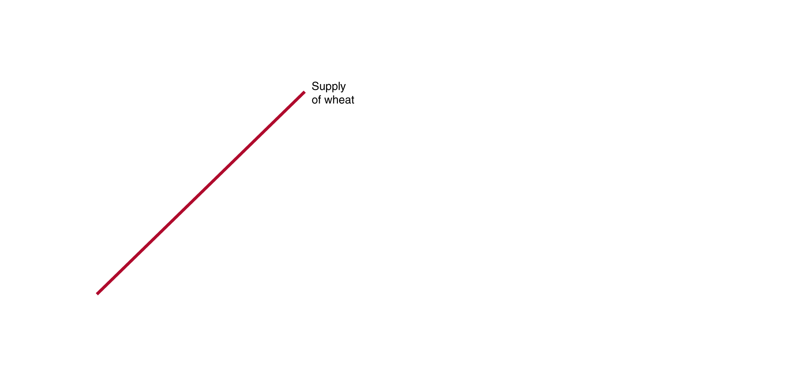
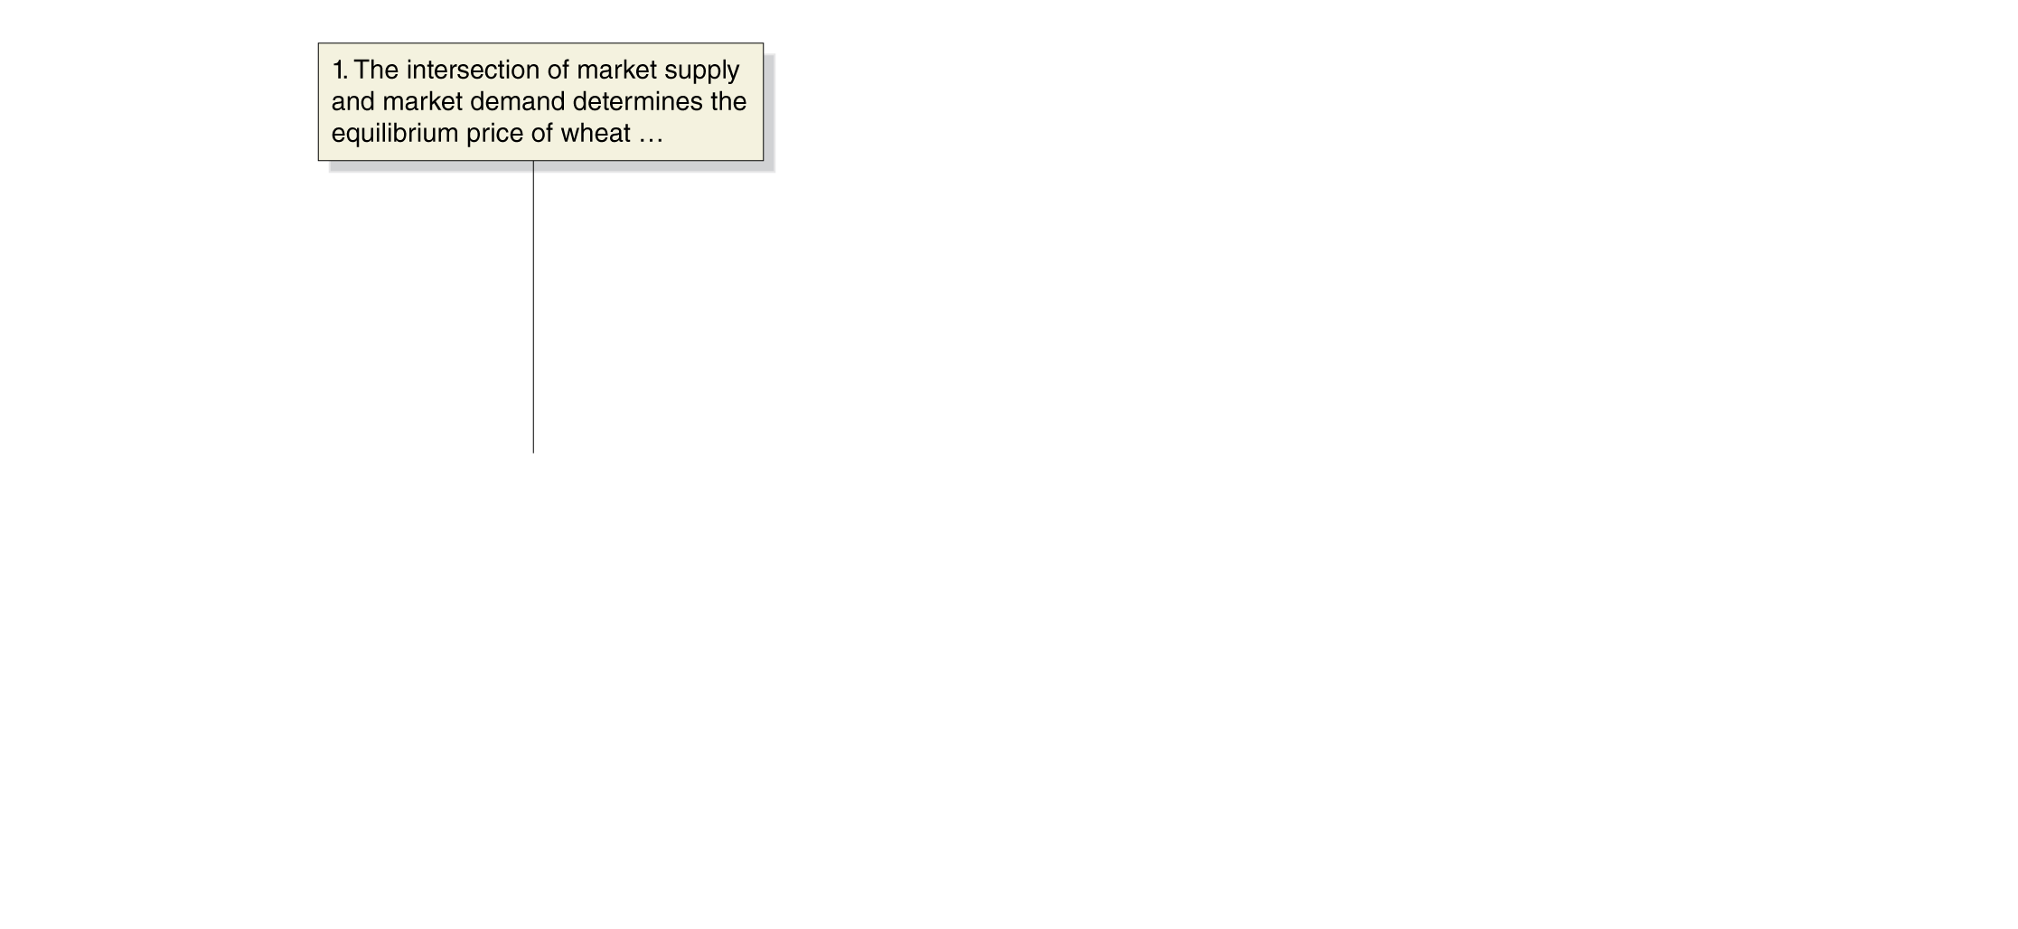
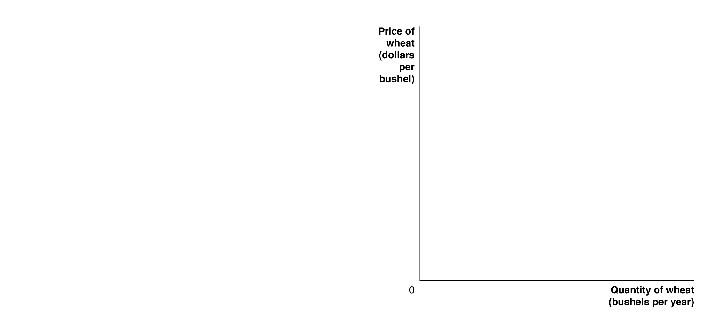
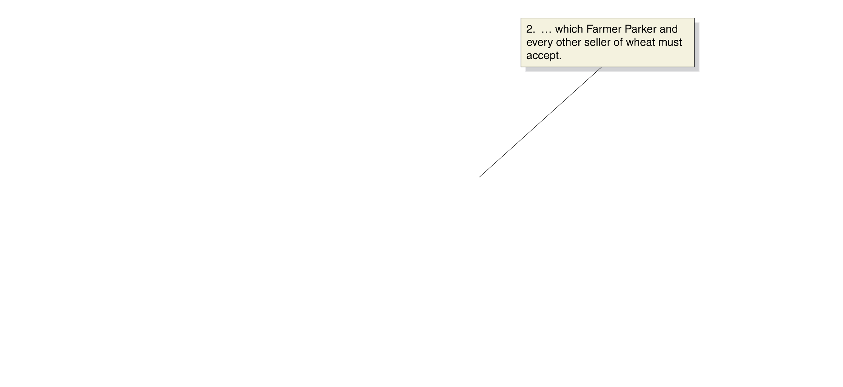
How is the firm’s demand curve determined
There are thousands of individual wheat farmers.
Their collective supply, combined with the overall market demand for wheat, determines the market price of wheat in the first panel.
The individual farmer takes this market price as his or her demand curve: the second panel.
Figure 12.2
The market demand for wheat versus the demand for one farmer’s wheat
Notes:
In a perfectly competitive market, price is determined by the intersection of market
demand and market supply. In panel (a), the demand and supply curves for wheat
intersect at a price of $7 per bushel. An individual wheat farmer like Farmer Parker
cannot affect the market price for wheat. Therefore, as panel (b) shows, the demand
curve for Farmer Parker’s wheat is a horizontal line. To understand this figure, it is
important to notice that the scales on the horizontal axes in the two panels are very
different. In panel (a), the equilibrium quantity of wheat is 2.25 billion bushels, and
in panel (b), Farmer Parker is producing only 15,000 bushels of wheat.

Slide 9
How a Firm Maximizes Profit in a Perfectly Competitive Market
12.2
Explain how a firm maximizes profit in a perfectly competitive market.

Slide 10
Profit maximization: the goal of the firm
We assume that all firms try to maximize profits—including perfectly competitive ones.
Recall that
Profit = Total Revenue – Total Cost
Revenue for a perfectly competitive firm is easy to analyze: the firm receives the same amount of money for every unit of output it sells. So
Price = Average Revenue = Marginal Revenue
This is illustrated in the table for an individual farmer, “Farmer Parker”, on the next slide.

Slide 11
Revenues for a perfectly competitive firm
Number of Bushels (Q) | Market Price (per bushel) (P) | Total Revenue (TR) | Average Revenue (AR) | Marginal Revenue (MR)
0 | $7 | $0 | - | -
1 | 7 | 7 | $7 | $7
2 | 7 | 14 | 7 | 7
3 | 7 | 21 | 7 | 7
4 | 7 | 28 | 7 | 7
5 | 7 | 35 | 7 | 7
6 | 7 | 42 | 7 | 7
7 | 7 | 49 | 7 | 7
8 | 7 | 56 | 7 | 7
9 | 7 | 63 | 7 | 7
10 | 7 | 70 | 7 | 7
For a firm in a perfectly competitive market, price is equal to both average revenue and marginal revenue.
Table 12.2
Farmer Parker’s revenue from wheat farming

Slide 12
Profit maximization for Farmer Parker
Quantity (bushels) (Q) | Total Revenue (TR) | Total Cost (TC)
0 | $0.00 | $10.00
1 | 7.00 | 14.00
2 | 14.00 | 16.50
3 | 21.00 | 18.50
4 | 28.00 | 21.00
5 | 35.00 | 24.50
6 | 42.00 | 29.00
7 | 49.00 | 35.50
8 | 56.00 | 44.50
9 | 63.00 | 56.50
10 | 70.00 | 72.00
Profit (TR – TC)
-$10.00
-7.00
-2.50
2.50
7.00
10.50
13.00
13.50
11.50
6.50
-2.00
Table 12.3
Farmer Parker’s profit from wheat farming
Suppose costs are as in the table.
We can calculate profit; profit is maximized at a quantity of 7 bushels. This is the profit-maximizing level of output.

Slide 13
Profit maximization for Farmer Parker: MR=MC
Quantity (bushels) (Q) | Total Revenue (TR) | Total Cost (TC) | Profit (TR – TC) | Marginal Revenue (MR) | Marginal Cost (MC)
0 | $0.00 | $10.00 | -$10.00 | - | -
1 | 7.00 | 14.00 | -7.00 | $7.00 | $4.00
2 | 14.00 | 16.50 | -2.50 | 7.00 | 2.50
3 | 21.00 | 18.50 | 2.50 | 7.00 | 2.00
4 | 28.00 | 21.00 | 7.00 | 7.00 | 2.50
5 | 35.00 | 24.50 | 10.50 | 7.00 | 3.50
6 | 42.00 | 29.00 | 13.00 | 7.00 | 4.50
7 | 49.00 | 35.50 | 13.50 | 7.00 | 6.50
8 | 56.00 | 44.50 | 11.50 | 7.00 | 9.00
9 | 63.00 | 56.50 | 6.50 | 7.00 | 12.00
10 | 70.00 | 72.00 | -2.00 | 7.00 | 15.50
Table 12.3
Farmer Parker’s profit from wheat farming
We can also calculate marginal revenue and marginal cost for the firm.
Profit is maximized by producing as long as MR>MC; or until MR=MC, if that is possible.

Slide 14
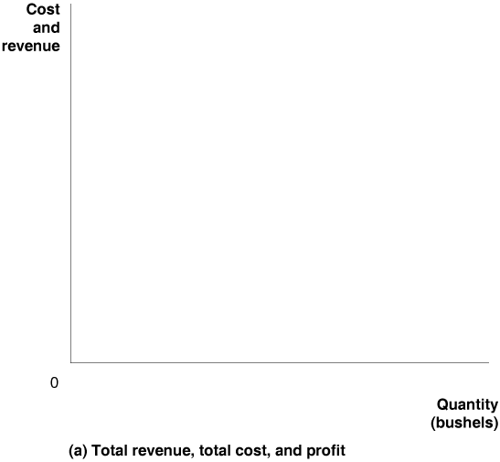
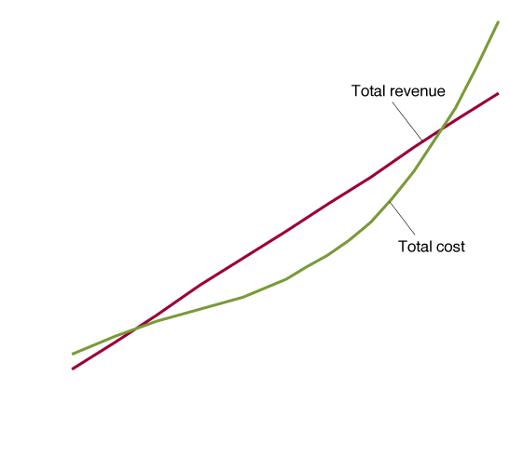
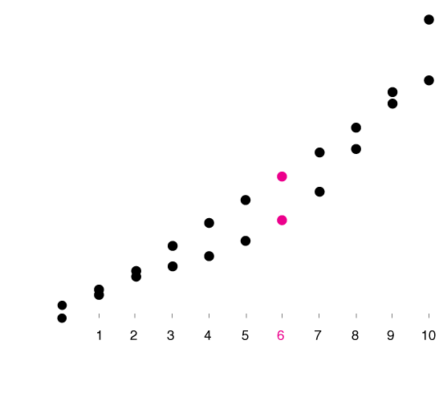
Showing revenue, cost, and profit
If we show total revenue and total cost on the same graph, the vertical difference between the two curves is the profit the firm makes.
(Or the loss, if costs are greater than revenues.)
At the profit-maximizing level of output, this (positive) vertical distance is maximized.
Figure 12.3a
The profit-maximizing level of output
Notes:
In panel (a), Farmer Parker maximizes his profit where the vertical distance
between total revenue and total cost is the largest, which occurs at an output
of 7 bushels. Panel (b) shows that Farmer Parker’s marginal revenue (MR) is
equal to a constant $7 per bushel. Farmer Parker maximizes profit by producing
wheat up to the point where the marginal revenue of the last bushel produced
is equal to its marginal cost, or MR = MC. In this case, at no level of output
does marginal revenue exactly equal marginal cost. The closest Farmer Parker
can come is to produce 7 bushels of wheat. He will not want to continue to produce
once marginal cost is greater than marginal revenue because that would
reduce his profits. Panels (a) and (b) show alternative ways of thinking about
how Farmer Parker can determine the profit-maximizing quantity of wheat to
produce.

Slide 15
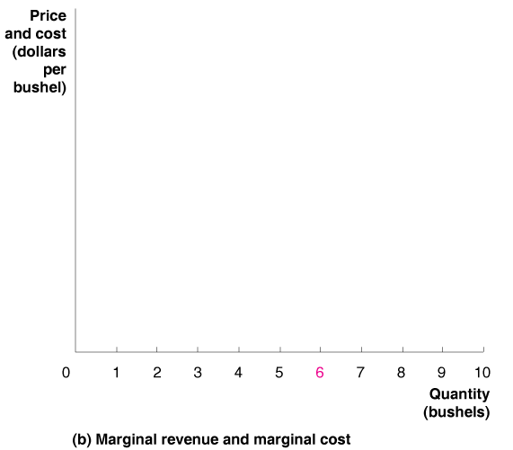
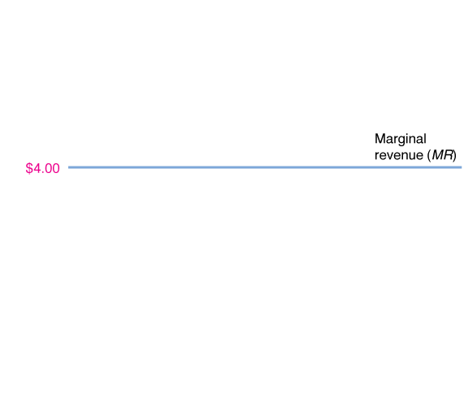
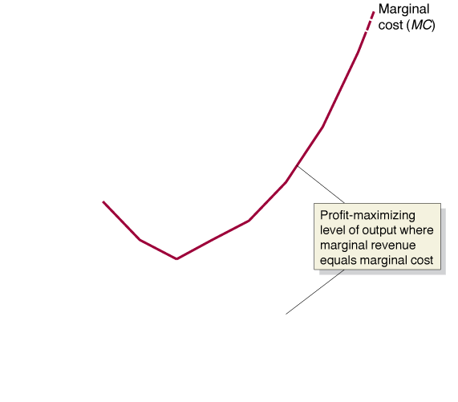
Showing marginal revenue and marginal cost
It is generally easier to determine the profit-maximizing level of output on a graph of marginal revenue and marginal cost.
Marginal revenue is constant and equal to price for the perfectly competitive firm.
The firm maximizes profit by choosing the level of output where marginal revenue is equal to marginal cost (or just less, if equal is not possible).
Figure 12.3b
The profit-maximizing level of output

Slide 16
Rules for profit maximization
The rules we have just developed for profit maximization are:
The profit-maximizing level of output is where the difference between total revenue and total cost is greatest; and
The profit-maximizing level of output is also where MR = MC.
However neither of these rules require the assumption of perfect competition; they are true for every firm!
For perfectly competitive firms, we can develop an additional rule, because for those firms, P = MR; this implies:
The profit-maximizing level of output is also where P = MC.

Slide 17
Illustrating Profit or Loss on the Cost Curve Graph
12.3
Use graphs to show a firm’s profit or loss.

Slide 18
A useful formula for profit
We know profit equals total revenue minus total cost; and total revenue is price times quantity. So write:
$Profit=(P×Q) −TC$
Dividing both sides by Q, we obtain:
$\frac{Profit}{Q}=\frac{(P×Q)}{Q} −\frac{TC}{Q}$
The “Q”s cancel in the first term, and the second is average total cost; so we can write:
$\frac{Profit}{Q}=P −ATC$
Multiplying both sides by Q, we obtain:
$Profit=\left(P −ATC\right)×Q$
The right hand side is the area of a rectangle with height (P – ATC) and length Q. We can use this to illustrate profit on a graph.

Slide 19
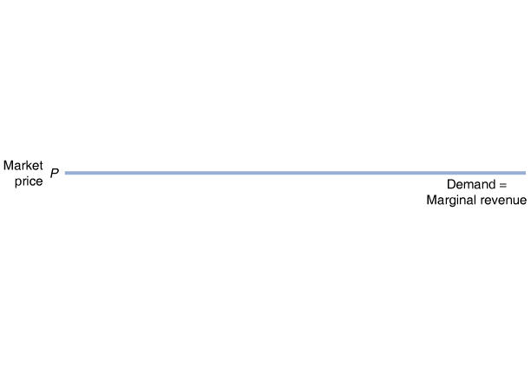
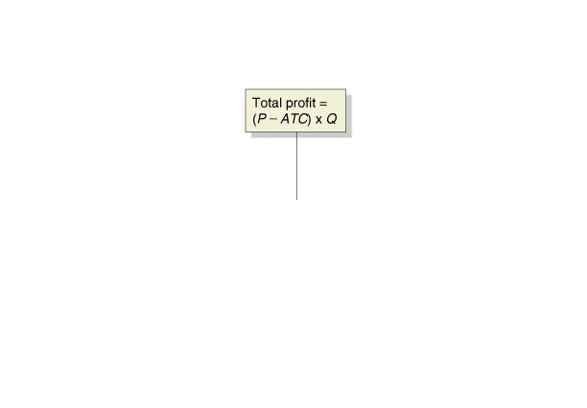
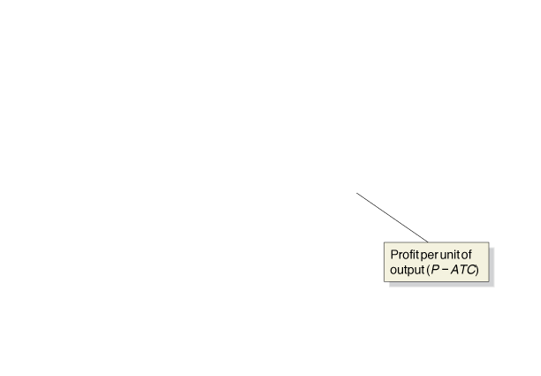
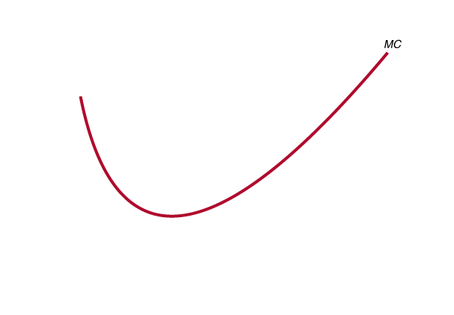
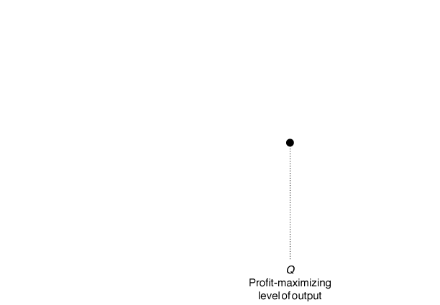
Showing the maximum profit on a graph
A firm maximizes profit at the level of output at which marginal revenue equals marginal cost.
The difference between price and average total cost equals profit per unit of output.
Total profit equals profit per unit of output, times the amount of output: the area of the green rectangle on the graph.
Figure 12.4
The area of maximum profit
Notes:
A firm maximizes profit at the level of output
at which marginal revenue equals marginal
cost. The difference between price and
average total cost equals profit per unit of
output. Total profit equals profit per unit
multiplied by the number of units produced.
Total profit is represented by the area of the
green-shaded rectangle, which has a height
equal to (P - ATC) and a width equal to Q.

Slide 20
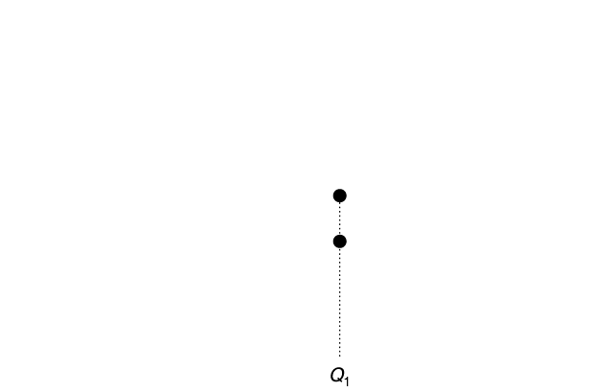
Incorrect level of output
It is a very common error to believe the firm should produce at Q₁: the level of output where profit per unit is maximized.
But this does NOT maximize overall profit; the next few units of output bring in more marginal revenue than their marginal cost.
You can know this because MR>MC at Q₁; this demonstrates that Q₁ is NOT the profit-maximizing level of output.
Figure 12.4
The area of maximum profit

Slide 21
Reinterpreting marginal revenue = marginal cost
We know we should produce at the level of output where marginal cost equals marginal revenue (MC=MR).
We have been calling this the profit-maximizing level of output. But what if the firm doesn’t make a profit at this level of output, or at any other?
In this case, we would want to make the smallest loss possible.
Note that sometimes a loss may be unavoidable, if we have high fixed costs.
It turns out that MC=MR is still the correct rule to use; it will guide us to the loss-minimizing level of output.

Slide 22
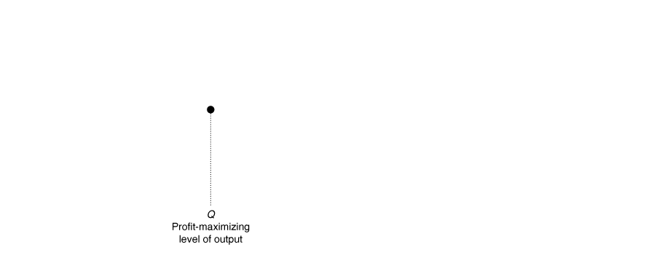
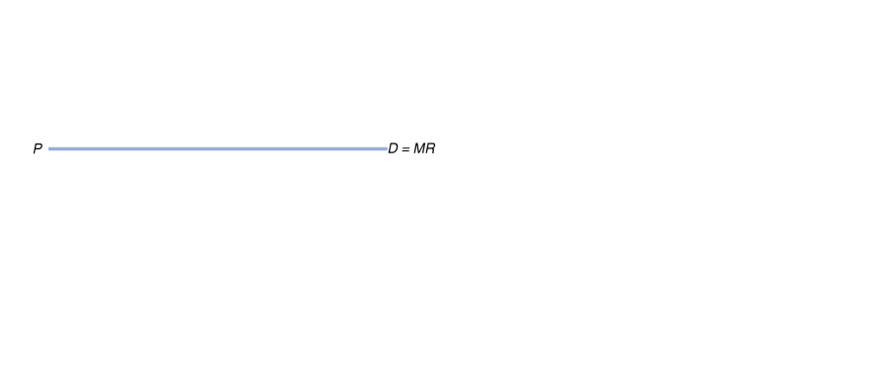
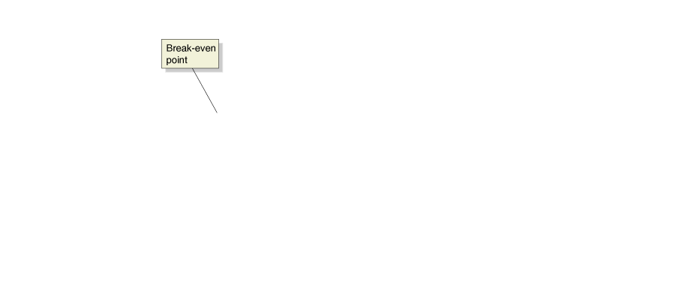
A firm breaking even
In the graph on the left, price never exceeds average cost, so the firm could not possibly make a profit.
The best this firm can do is to break even, obtaining no profit but incurring no loss.
The MC=MR rule leads us to this optimal level of production.
Figure 12.5
A firm breaking even and a firm experiencing a loss
Notes:
In panel (a), price equals average total cost, and the firm breaks even because its
total revenue will be equal to its total cost. In this situation, the firm makes zero
economic profit.
In panel (b), price is below average total cost, and the firm experiences a loss. The
loss is represented by the area of the red-shaded rectangle, which has a height
equal to (ATC – P) and a width equal to Q.

Slide 23
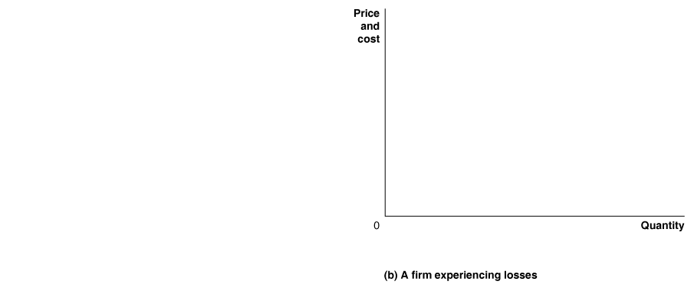
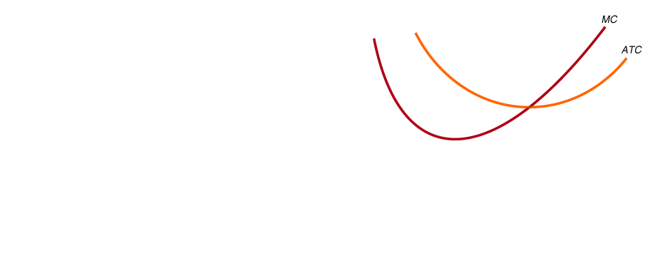
A firm experiencing a loss
The situation is even worse for this firm; not only can it not make a profit, price is always lower than average total cost, so it must make a loss.
It makes the smallest loss possible by again following the MC=MR rule.
No other level of output allows the firm’s loss to be so small.
Figure 12.5
A firm breaking even and a firm experiencing a loss

Slide 24
Identifying whether a firm can make a profit
Once we have determined the quantity where MC=MR, we can immediately know whether the firm is making a profit, breaking even, or making a loss. At that quantity,
If P > ATC, the firm is making a profit
If P = ATC, the firm is breaking even
If P < ATC, the firm is making a loss
Even better: these statements hold true at every level of output.

Slide 25
Deciding Whether to Produce or to Shut Down in the Short Run
12.4
Explain why firms may shut down temporarily.

Slide 26
Responses of perfectly competitive firms to losses
Suppose a firm in a perfectly competitive market is making a loss. It would like the price to be higher, but it is a price-taker, so it cannot raise the price. That leaves two options:
Continue to produce, or
Stop production by shutting down temporarily
If the firm shuts down, it will still need to pay its fixed costs. The firm needs to decide whether to incur only its fixed costs, or to produce and incur some variable costs, but obtain some revenue.
The firm’s fixed costs should be treated as sunk costs, costs that have already been paid and cannot be recovered, because even if they haven’t literally been paid yet, the firm is still obliged to pay them.
Sunk costs should be irrelevant to your decision-making.

Slide 27
The supply curve of a firm in the short run
The firm’s shut down decision is based on its variable costs; it should produce nothing only if:
Total Revenue < Variable Cost
(P x Q) < VC
Dividing both sides by Q, we obtain:
P < AVC
So if P < AVC, the firm should produce 0 units of output.
If P > AVC, then the MC = MR rule should guide production: produce the quantity where MC = MR. For a perfectly competitive firm, this means where MC = P.
So the marginal cost curve gives us the relationship between price and quantity supplied: it is the firm’s supply curve!

Slide 28
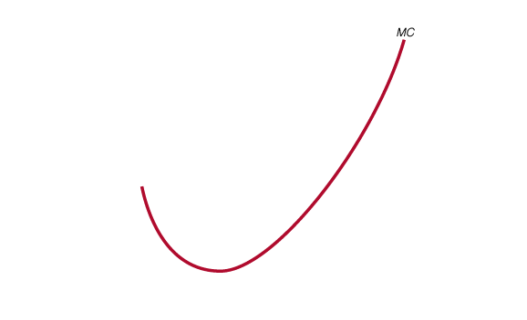
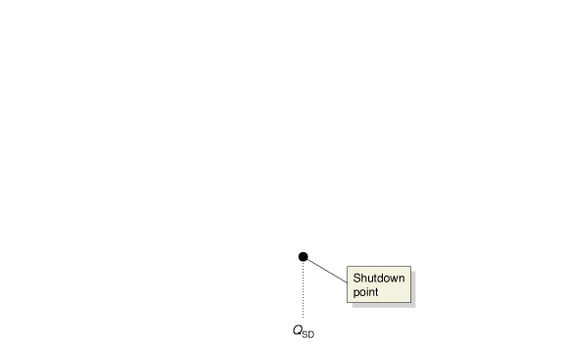
The firm’s short-run supply curve
The firm will produce at the level of output at which MR = MC.
Because price equals marginal revenue for a firm in a perfectly competitive market, the firm will produce where P = MC.
So the firm supplies output according to its marginal cost curve; the marginal cost curve is the supply curve for the individual firm.
However if the price is too low, i.e. below the minimum point of AVC, the firm will produce nothing at all.
The quantity supplied is zero below this point.
Figure 12.6
The firm’s short-run supply curve
Notes:
Because price equals marginal revenue for
a firm in a perfectly competitive market,
the firm will produce where P = MC. For
any given price, we can determine the quantity
of output the firm will supply from the
marginal cost curve, so the marginal cost
curve is the firm’s supply curve. But the firm
will shut down if the price falls below average
variable cost. The marginal cost curve
crosses the average variable cost at the firm’s
shutdown point at the output level QSD. For
prices below PMIN, the supply curve is a vertical
line along the price axis, which shows
that the firm will supply zero output at those
prices. The red line is the firm’s short-run
supply curve.

Slide 29
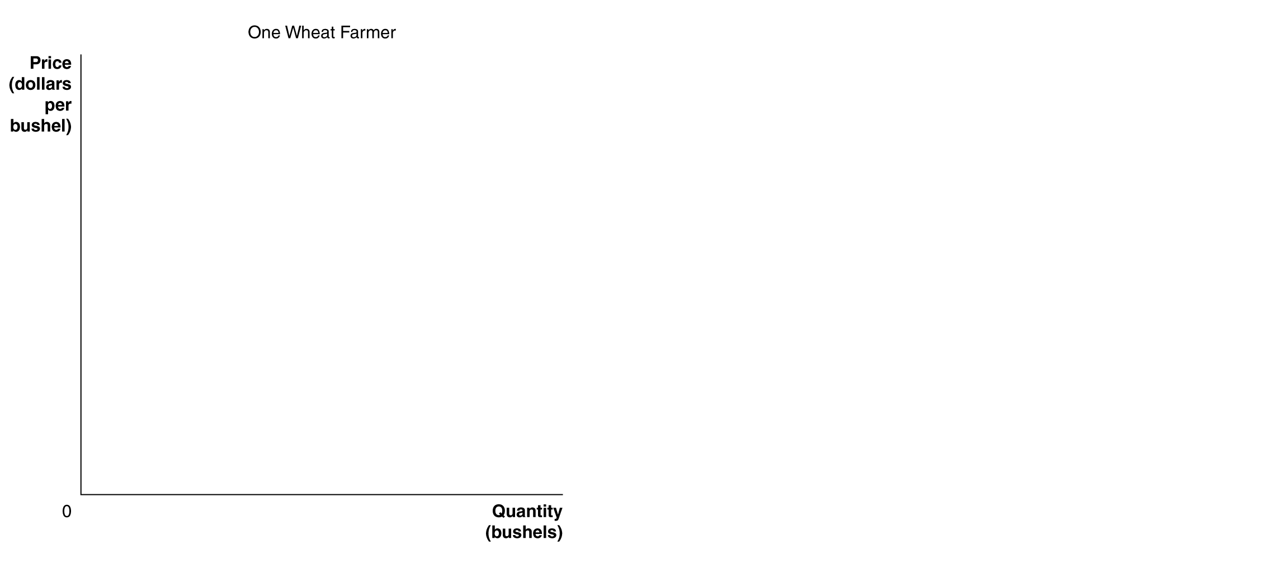
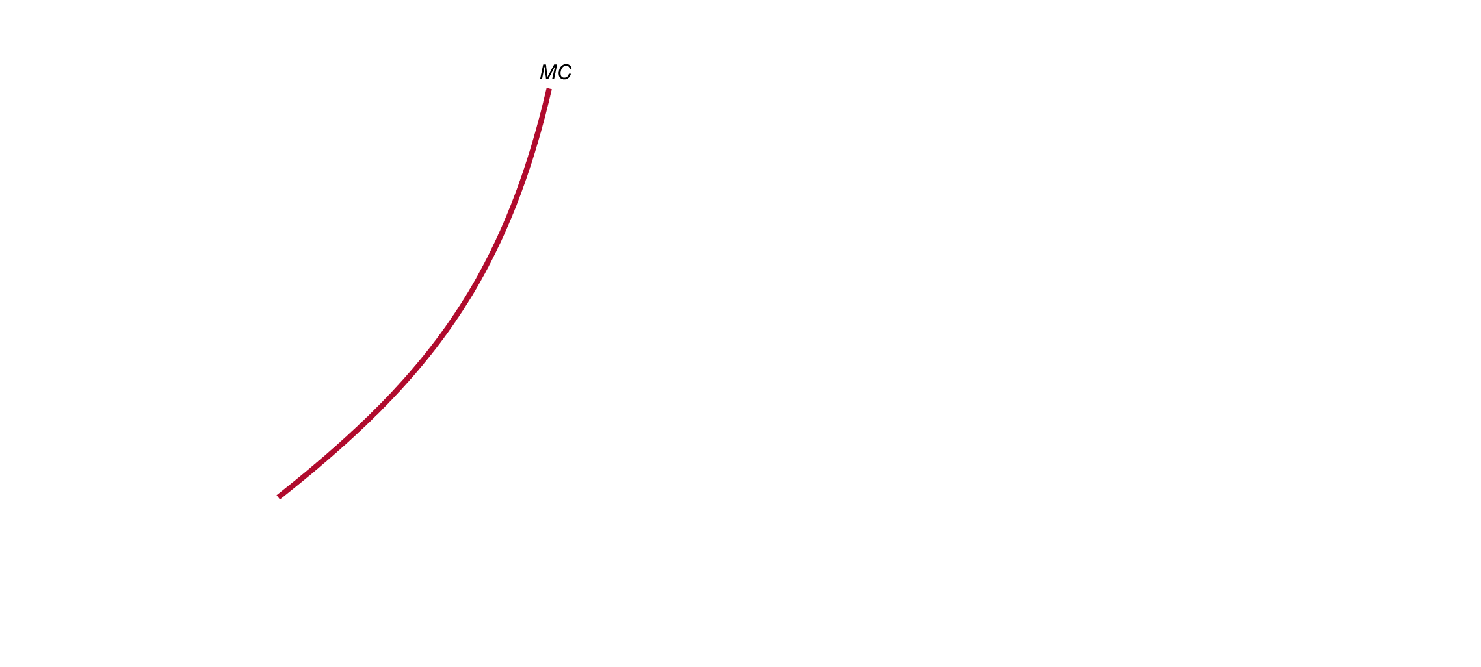
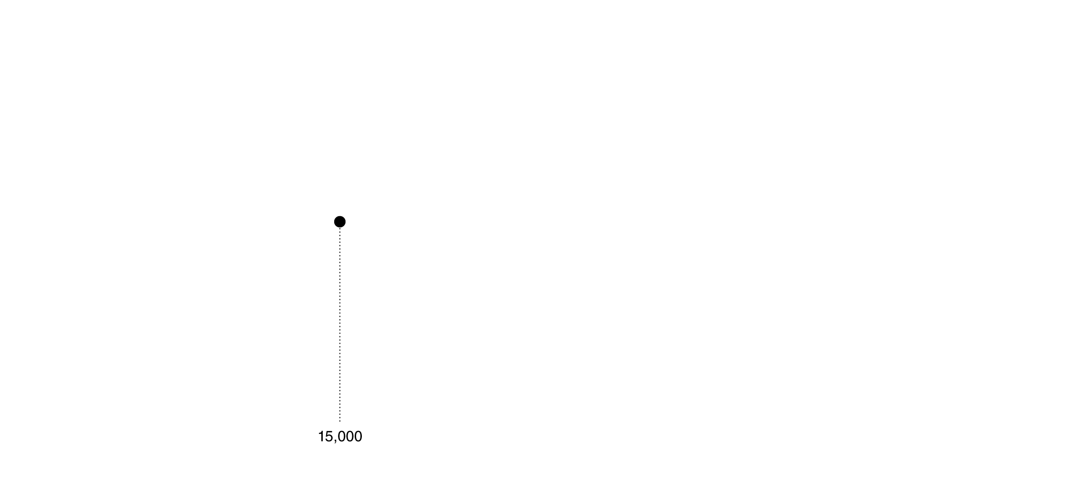
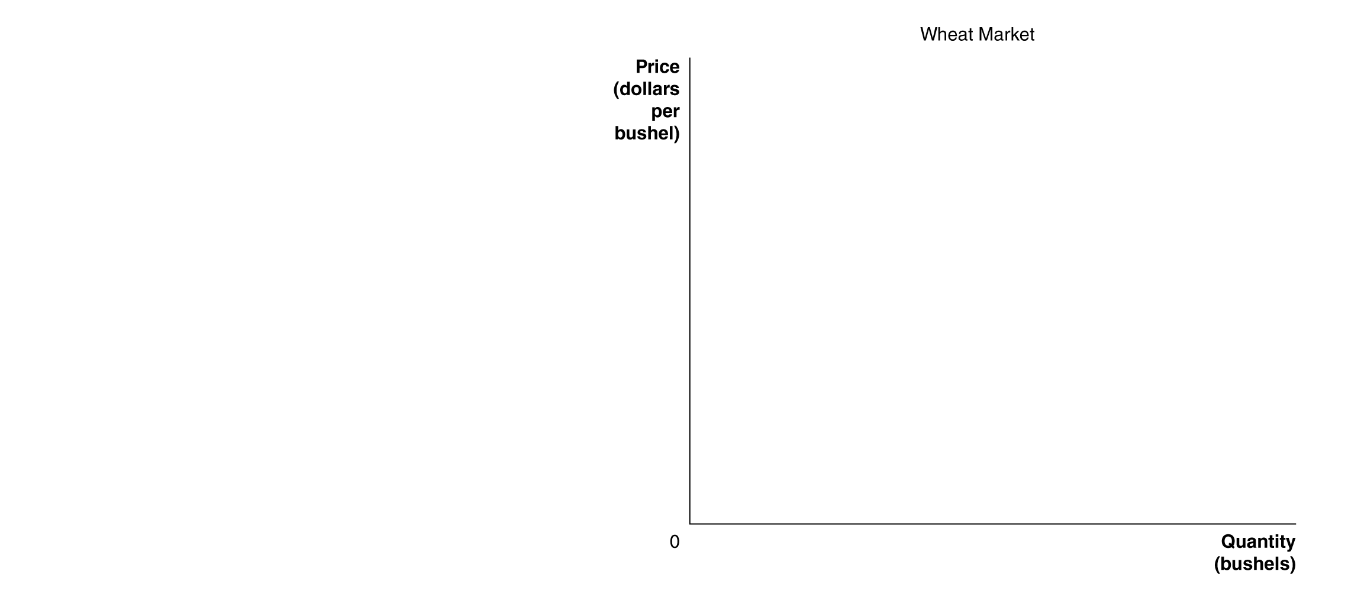
Short-run market supply curve
Figure 12.7
Firm supply and market supply
Individual wheat farmers take the price as given…
…and choose their output according to the price.
The collective actions of the individual farmers determine the market supply curve for wheat.
Notes:
We can derive the market supply curve by adding up the quantity that each firm
in the market is willing to supply at each price. In panel (a), one wheat farmer is
willing to supply 15,000 bushels of wheat at a price of $7 per bushel. If every wheat
farmer supplies the same amount of wheat at this price and if there are 150,000
wheat farmers, the total amount of wheat supplied at a price of $7 will equal
15,000 bushels per farmer * 150,000 farmers = 2.25 billion bushels of wheat.
This amount is one point on the market supply curve for wheat shown in panel
(b). We can find the other points on the market supply curve by determining how
much wheat each farmer is willing to supply at each price.

Slide 30
“If Everyone Can Do It, You Can’t Make Money at It”: The Entry and Exit of Firms in the Long Run
12.5
Explain how entry and exit ensure that perfectly competitive firms earn zero economic profit in the long run.

Slide 31
Costs for a small carrot-farmer
Sacha starts a small carrot farm, borrowing money from the bank and using some of her savings.
Her explicit costs are straight-forward; her implicit costs include the opportunity cost of using her savings, and the salary she gives up to start the farm.
Sacha produces 10,000 boxes of carrots each year, and sells them for $15 each. Her total revenue is $150,000.
Sacha’s farm makes an economic profit of $25,000 per year.
Explicit Costs
Water Wages Fertilizer Electricity Payment on bank loan | $10,000 $15,000 $10,000 $5,000 $45,000
Implicit Costs
Forgone salary Opportunity cost of the $100,000 she has invested in her farm | $30,000 $10,000
Total cost | $125,000
Table 12.4
Farmer Gillette’s costs per year

Slide 32
Economic profit leads to entry of new firms
Unfortunately for Sacha, the profits in the carrot-farming business will not last. Why?
Additional firms will enter the market, attracted by the profit. Perhaps:
Some farms will switch from other produce to carrots, or
People will open up new farms.
However it happens, the number of firms in the market will increase, increasing supply; this will in turn lower the price Sacha can receive for her output.

Slide 33
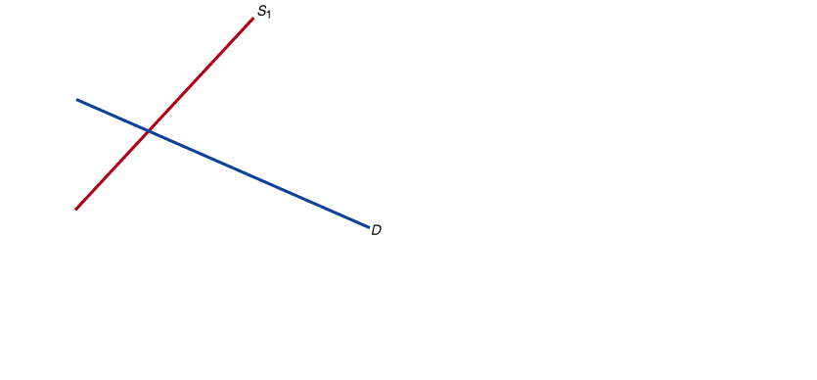
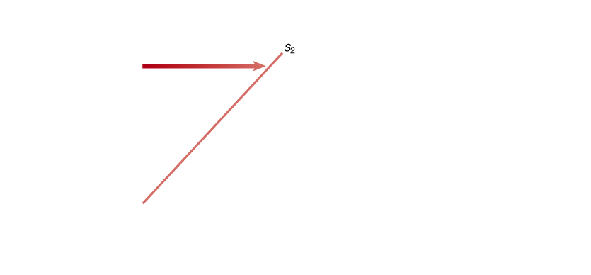
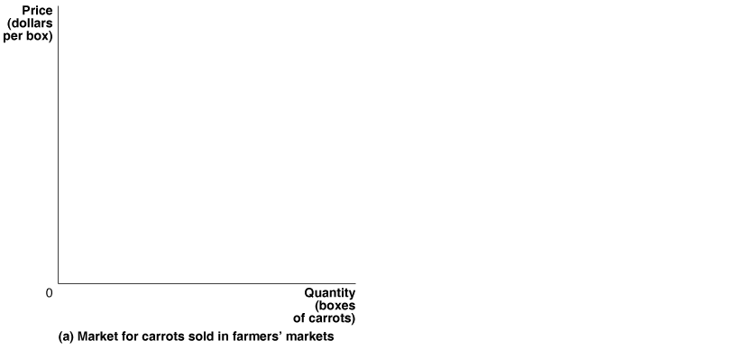
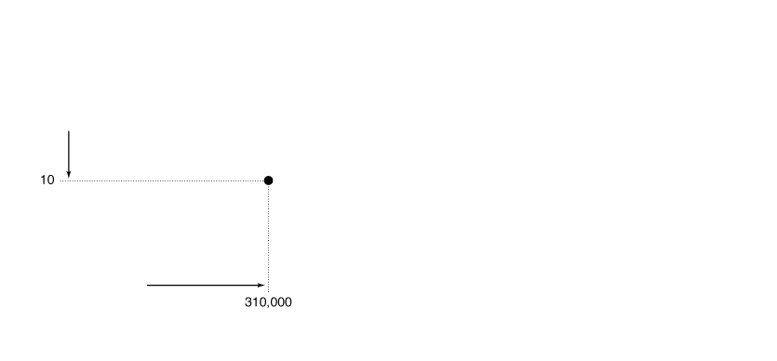
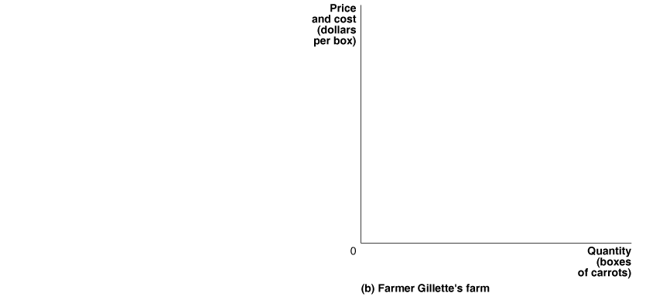
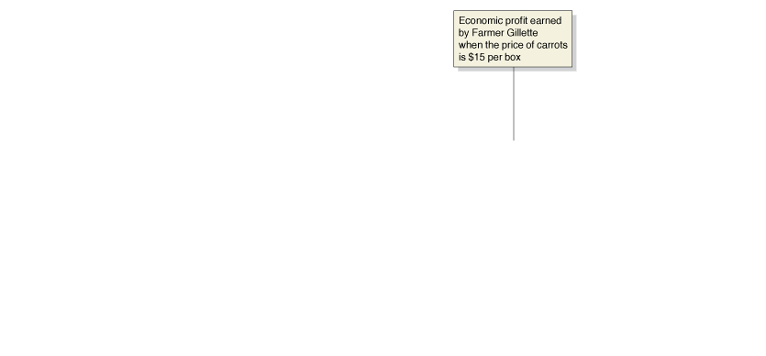
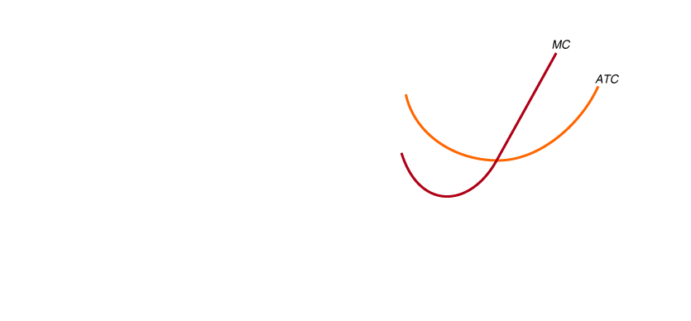
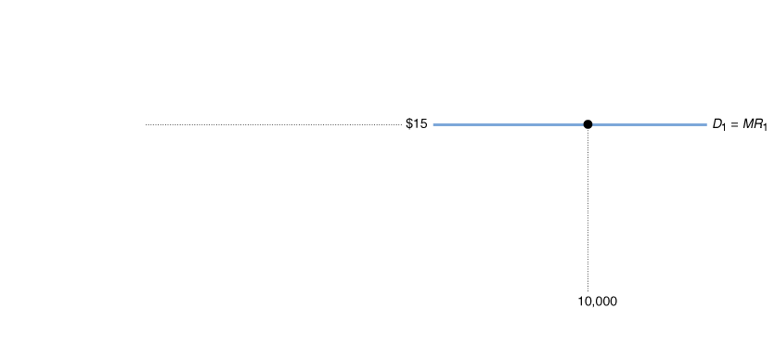
The effect of entry on economic profit
Figure 12.8
The effect of entry on economic profit
Sacha Gillette’s costs are given in the panel on the right.
The price of output is determined by the market, on the left.
Sacha makes an economic profit when the price is $15.
The profit attracts new firms, which increases supply.
Notes:
Initially, Farmer Gillette and other farmers selling carrots in farmers’ markets are
able to charge $15 per box and earn an economic profit. Farmer Gillette’s economic
profit is represented by the area of the green box in panel (b). Panel (a) shows
that as other farmers begin to sell carrots in farmers’ markets, the market supply
curve shifts to the right, from S1 to S2, and the market price drops to $10 per box.
Panel (b) shows that the falling price causes Farmer Gillette’s demand curve to shift
down from D1 to D2, and she reduces her output from 10,000 boxes to 8,000. At the
new market price of $10 per box, carrot growers are just breaking even: Their total
revenue is equal to their total cost, and their economic profit is zero. Notice the difference
in scale between the graphs in panels (a) and (b).

Slide 34
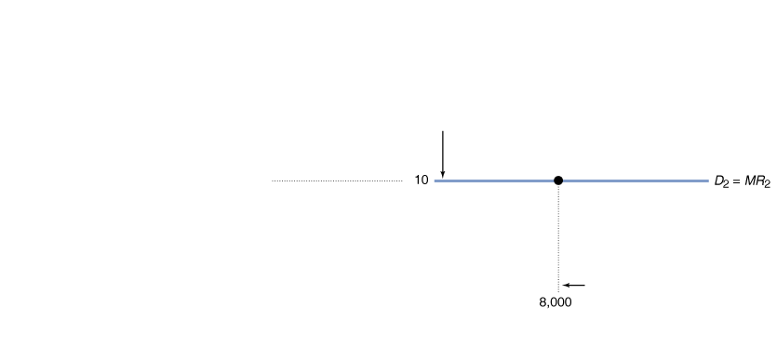
The effect of entry on economic profit—continued
Figure 12.8
The effect of entry on economic profit
The increased supply causes the market equilibrium price to fall.
It falls until there is no incentive for further firms to enter the market; that is, when individual farmers make no economic profit.
For this to be true, the price must be equal to ATC; but since P=MC, that means all three must be equal.

Slide 35
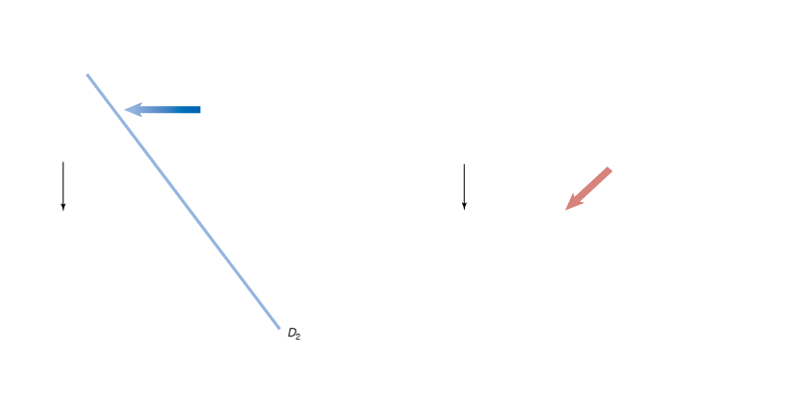
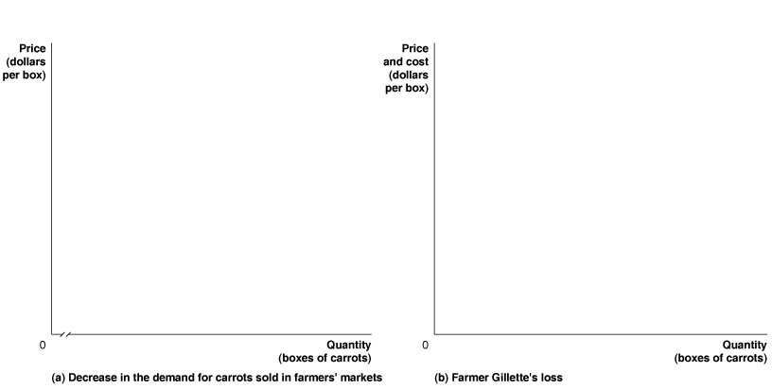
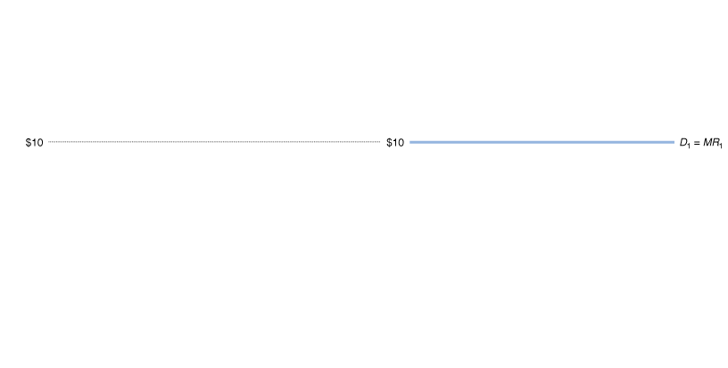
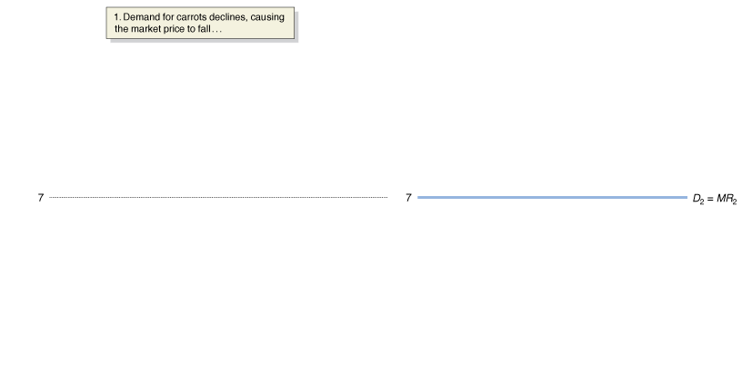
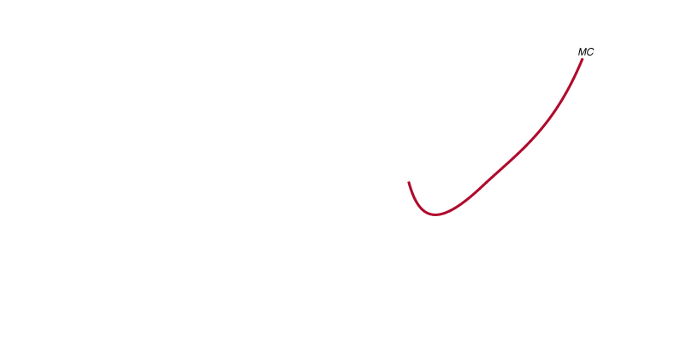
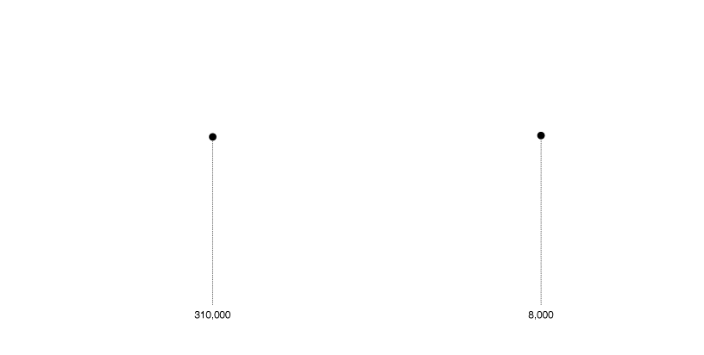
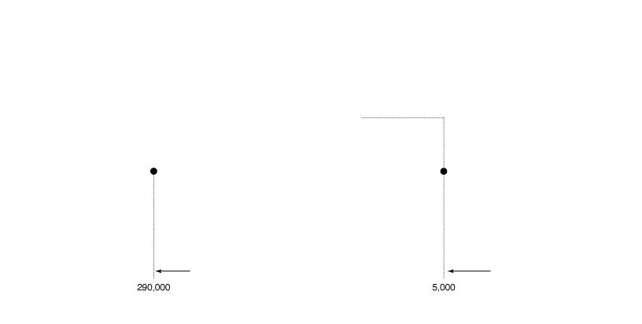
The effect of economic losses
Figure 12.9a,b
The effect of exit on economic losses
Price is $10 per box, and carrot-farmers are breaking even.
Then demand for carrots falls. Price falls to $7 per box.
Sacha can no longer make a profit; she makes the smallest loss possible by producing 5000 carrots: where MC = MR.
Notes:
When the price of carrots is $10 per box, Farmer Gillette and other farmers are breaking
even. A total quantity of 310,000 boxes is sold in the market. Farmer Gillette sells
8,000 boxes. Panel (a) shows a decline in the demand for carrots sold in farmers’
markets from D1 to D2 that reduces the market price to $7 per box. Panel (b) shows
that the falling price causes Farmer Gillette’s demand curve to shift down from D1 to
D2 and her output to fall from 8,000 to 5,000 boxes. At a market price of $7 per box,
farmers have economic losses, represented by the area of the red box. As a result, some
farmers will exit the market, which shifts the market supply curve to the left. Panel (c)
shows that exit continues until the supply curve has shifted from S1 to S2 and the market
price has risen from $7 back to $10. Panel (d) shows that with the price back at $10,
Farmer Gillette will break even. In the new market equilibrium in panel (c), total sales
of carrots in farmers’ markets have fallen from 310,000 to 270,000 boxes.

Slide 36
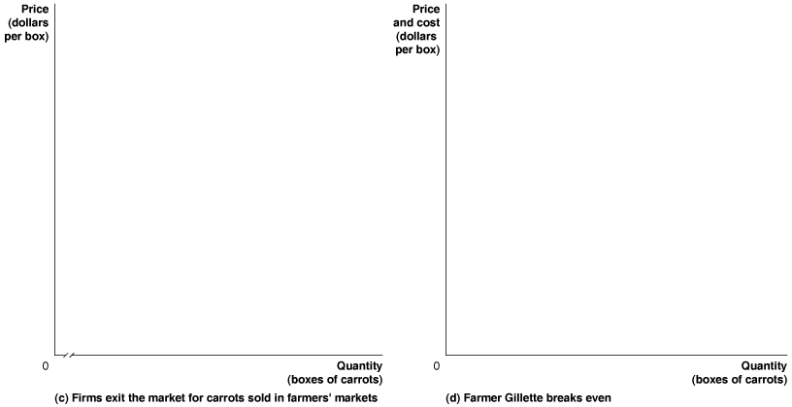
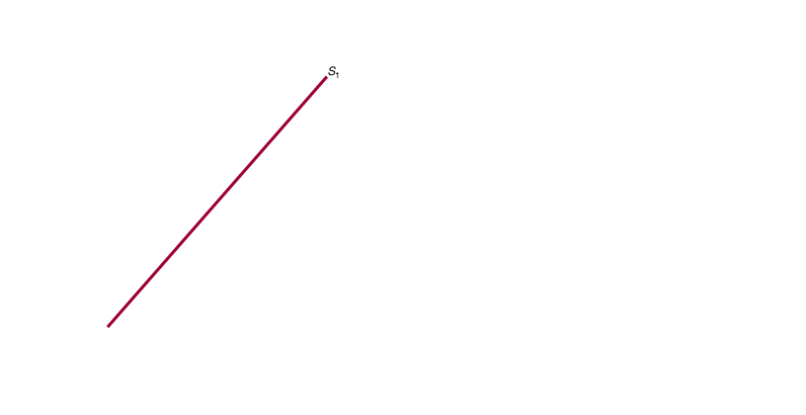
The effect of economic losses—continued
Figure 12.9c,d
The effect of exit on economic losses
Discouraged by the losses, some firms will exit the market.
The resulting decrease in supply causes prices to rise.
Firms continue to leave until price returns to the break-even price of $10 per box.

Slide 37
Long-run equilibrium in a perfectly competitive market
The previous slides have described how long-run competitive equilibrium is achieved in a perfectly competitive market:
If firms are making an economic profit, additional firms enter the market, driving down price to the break-even level.
If firms are making an economic loss, existing firms exit the market, driving price up to the break-even level.
Since the long-run average cost curve shows the lowest cost at which a firm is able to produce a given quantity of output in the long run, we expect price to be driven down to the minimum point on the typical firm’s long-run average cost curve.
Long-run competitive equilibrium: The situation in which the entry and exit of firms has resulted in the typical firm breaking even.

Slide 38
Long-run supply in a perfectly competitive market
This means that in the long run, the market will supply any demand by consumers at a price equal to the minimum point on the typical firm’s average cost curve.
Hence the long-run supply curve is horizontal at this price.
In a perfectly competitive market, the long-run price is completely determined by the forces of supply.
The number of suppliers adjusts to meet demand, at the lowest possible price.
Long-run supply curve: A curve that shows the relationship in the long run between market price and the quantity supplied.

Slide 39
Long-run supply
Figure 12.10
The long-run supply curve in a perfectly competitive industry
The panels show how an increase or decrease in demand is met by a corresponding increase or decrease in supply.
Price always returns to the long-run (break-even) level.
Notes:
Panel (a) shows that an increase in demand for carrots sold in farmers’ markets
will lead to a temporary increase in price from $10 to $15 per box, as the market
demand curve shifts to the right, from D1 to D2. The entry of new firms shifts
the market supply curve to the right, from S1 to S2, which will cause the price to
fall back to its long-run level of $10. Panel (b) shows that a decrease in demand
will lead to a temporary decrease in price from $10 to $7 per box, as the market
demand curve shifts to the left, from D1 to D2. The exit of firms shifts the market
supply curve to the left, from S1 to S2, which causes the price to rise back to
its long-run level of $10. The long-run supply curve (SLR) shows the relationship
between market price and the quantity supplied in the long run. In this case, the
long-run supply curve is a horizontal line.

Slide 40
Easy entry makes the long run pretty short
When firms earn economic profits in a market, other firms have a strong economic incentive to enter that market.
This is exactly what happened with iPhone apps, first provided by Apple in mid-2008. Proving to be highly profitable in an instant, more than 25,000 apps were available in the iTunes store within a year.
The cost of entering this market was very small. Anyone with the programming skills and the time to write an app could have it posted in the store.
As a result of this enhanced competition, the ability to get rich quick with a killer app faded quickly.

Slide 41
Increasing-cost and diminishing-cost industries
Industries where the production process is infinitely replicable are modeled well by this horizontal supply curve.
But what if this is not the case?
If some factor of production cannot be replicated, additional firms may have higher costs of production.
Example: If certain grapes grow well only in certain climates, then the cost to produce additional grapes may be higher than for existing firms.
On the other hand, sometimes additional firms might generate benefits for other firms in the market, leading additional firms to have lower costs of production.
Example: Cell phones require specialized processors. As more firms produce cell phones, economies of scale in processor-production reduce cell phone costs.

Slide 42
Perfect Competition and Efficiency
12.6
Explain how perfect competition leads to economic efficiency.

Slide 43
Types of efficiency
Efficiency in economics really refers to two separate but related concepts:
Productive efficiency is a situation in which a good or service is produced at the lowest possible cost.
Allocative efficiency is a state of the economy in which production represents consumer preferences; in particular, every good or service is produced up to the point where the last unit provides a marginal benefit to consumers equal to the marginal cost of producing it.

Slide 44
Are perfectly competitive markets efficient?
We have shown that in the long run, perfectly competitive markets are productively efficient.
But they are allocatively efficient also:
The price of a good represents the marginal benefit consumers receive from consuming the last unit of the good sold.
Perfectly competitive firms produce up to the point where the price of the good equals the marginal cost of producing the good.
Therefore, firms produce up to the point where the last unit provides a marginal benefit to consumers equal to the marginal cost of producing it.
Productive and allocative efficiency are useful benchmarks against which to measure the actual performance of other markets.

Slide 45
Common misconceptions to avoid
While a perfectly competitive firm faces a horizontal demand curve, the market demand curve is still “normal” (downward-sloping).
In this chapter there are many supply curves described: the individual firm’s supply curve, the market short-run supply curve, the market long-run supply curve; do not confuse these.
Remember that “zero economic profit” is an adequate level of profit to cover opportunity costs; it is not a bad outcome for a firm.
The reasons for shutting down in the short run and exiting the market in the long run are different: P<AVC for the short run, P<ATC for the long run.

